Slide 1

Data Preparation
Gerrit Gruben, 19. September 2017

Slide 2
Outline
Understanding the concept of data representation and why it is important to machine learning;
Learn about techniques of data preparation and feature engineering and when they are relevant including the “missing value” case;
Outlook: Deep learning as a deep feature synthesizing.

Slide 3
Data Representation

Slide 4
Data Representation
Data representation is simply the form of the data that is presented to the learner.
This can be transforming existing numbers, enumerating classes, recombination of existing features, …
… but also includes representing unstructured data (e.g. text) in terms of vectors.
Dimensionality reduction techniques are also changing the data‘s representation.

Slide 5
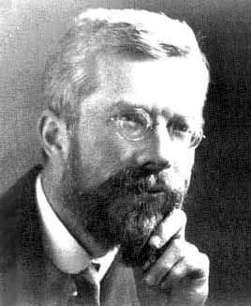
Fisher‘s Iris family data set
Setosa
Virginica
Versicolor

Slide 6
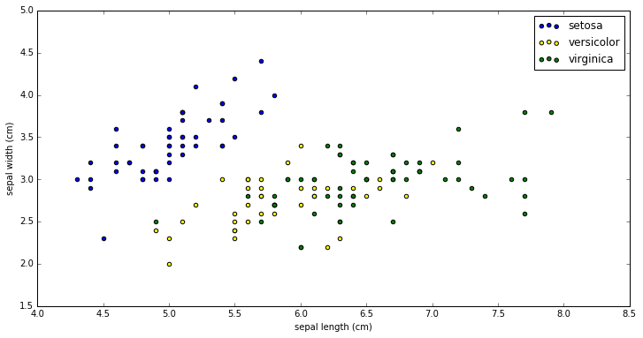
Original dataset

Slide 7
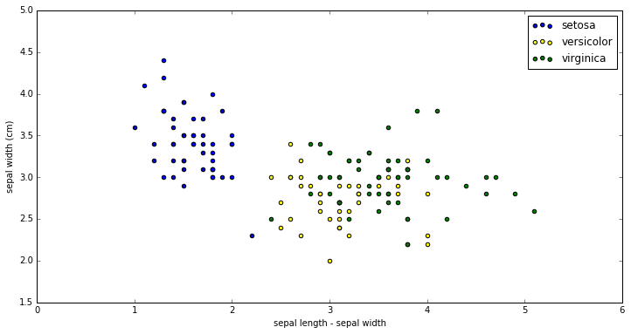
Mapping length -> length - width

Slide 8
Insight
The complexity of discriminating Iris setosa from the other two has been reduced from finding a line equation to a one-dimensional check.
This is what deep learning neuronal networks are supposed to do: successive transformation of the data representation.
Can be seen as a „cheap“ trick, because we simply moved the linear transformation to the preprocessing. Think of higher dimensions.

Slide 9


Slide 10
Data Preprocessing

Slide 11
Types of input features
Categorical variables
Ordinal
Numerical variables
Floats
Counts
Strings
Sequence data
Time series (time order)
Sequences of strings (text data)
Location data

Slide 12
Categorical
High cardinality can create very sparse data. (hint: SVMs, linear w/ L1-reg. aka Lasso good on high-dim. sparse data)
Are all categories in the ground truth?
Replacing missing values is tough, either try to predict from the other features or set a explicit „unknown“ category.
Encodings (k = #classes)
Onehot: 0-1 vector with 1 to identify class, others 0. (Sparse)
Label: Map classes to 1, …, k.
"Feature Hashing": Two versions, either set the 0-1 in onehot by the value of one hash function with a small bag size or use the values of several hash functions as vector (has integer entries).
Count: Replace categories with their frequency in the data set.
LabelCount: Same as count, but use the rank of the counts.
Target: Replace class with the overall ratio of target variable, this is a first naive form of replacing missing values via predictors. Quickly overfits. (see meta-learning in model evaluation unit).
Manual extractions (e.g. HTTP_USER_AGENT → OS, device, browser, …)

Slide 13
from sklearn.preprocessing import OneHotEncoder
oh_enc = OneHotEncoder(
n_values="auto", # num. of. cats
categorical_features="all", # which are categorical?
sparse=True # hold as sparse?
)
oh_enc.fit(some_data)
some_data = oh_enc.transform(some_data)
# or in one:
some_data = oh_enc.fit_transform(some_data)
# optionally: to_array() to go back from sparse representation

Slide 14
from sklearn.preprocessing import OneHotEncoder
oh_enc = OneHotEncoder(
n_values="auto", # num. of. cats
categorical_features="all", # which are categorical?
sparse=True # hold as sparse?
)
oh_enc.fit(some_data)
some_data = oh_enc.transform(some_data)
# or in one:
some_data = oh_enc.fit_transform(some_data)
# optionally: to_array() to go back from sparse representation

Slide 15
Numerical
Rounding: several variations, e.g. map to an integer and bin the remainder. Counteracts noise.
Binning: put values into bin categories (e.g. intervals)
Scaling:
Z-scaling
min-max scaling
Normalize to unit-norm (used in Information Retrieval)
log-transform, log-log, … (find in explorative analysis)
Many machine learning models assume Z-scaling! (SVM with RBF kernel, L1/L2 regularizers of linear models)

Slide 16
from sklearn.preprocessing import Imputer, StandardScaler, MinMaxScaler, Normalizer
import numpy as np
# mean imputation
imp = Imputer(missing_values="NaN", strategy="mean", axis=0)
imp.fit(train_data) # find mean
# Z-Scaling
scaler = StandardScaler(copy=True, # fragile optimization
with_mean=True, # rarely to False
with_std=True)
some_data = scaler.fit_transform(some_data)
# min-max scaling
MinMaxScaler(feature_range=(a,b)) # scales on interval [a, b]
# log-scaling, if ith column is > 0
X[:, i] = np.log(X[:, i])
# normalizer (text processing)
norm = Normalizer(norm="l2") # or "l1"
# binning
x = np.array([0.5, 6.2, 3.0, 1.8])
bins = np.array([0.0, 1.0, 2.5, 4.0, 10.0])
new_x = np.digitize(x, bins) # create bins with np.histogram()

Slide 17
Strings
Bag-of-words
TF-IDF
Word2Vec (best done with gensim)
semantic embedding
train on a language's corpus

Slide 18
Bag-of-Words
Given a collection d₁, …, d_{n} of documents, obtain all unique words w₁, ..., w_{k}appearing in there. The bag of words for d_{i} is a vector of length k, where the j-th position indicates whether w_{j} is in d_{i}.
Term | Frequency
this | 1
is | 1
a | 1
sample | 3
Term | Frequency
this | 1
is | 1
another | 2
example | 3
w = [this, is, a, sample, another, example]
v₁ = (1, 1, 1, 1, 0, 0)
v₂ = (1, 1, 0, 0, 1, 1)
Notes:
Explain n-grams, sparse data structures, using counts.
A common alternative to the use of dictionaries is the hashing trick, where words are directly mapped to indices with a hashing function.^{[4]} By mapping words to indices directly with a
hash function, no memory is required to store a dictionary. Hash collisions are typically dealt with by using freed-up memory to increase the number of hash buckets. In practice, hashing greatly simplifies the implementation of bag-of-words models and improves their scalability.

Slide 19
Bag-of-Words
Given a collection d₁, …, d_{n} of documents, obtain all unique words w₁, ..., w_{k}appearing in there. The bag of words for d_{i} is a vector of length k, where the j-th position indicates whether w_{j} is in d_{i}.
Term | Frequency
this | 1
is | 1
a | 1
sample | 3
Term | Frequency
this | 1
is | 1
another | 2
example | 3
w = [this, is, a, sample, another, example]
v₁ = (1, 1, 1, 3, 0, 0)
v₂ = (1, 1, 0, 0, 2, 3)
Notes:
Explain n-grams, sparse data structures, using counts.
A common alternative to the use of dictionaries is the hashing trick, where words are directly mapped to indices with a hashing function.^{[4]} By mapping words to indices directly with a
hash function, no memory is required to store a dictionary. Hash collisions are typically dealt with by using freed-up memory to increase the number of hash buckets. In practice, hashing greatly simplifies the implementation of bag-of-words models and improves their scalability.

Slide 20
Bag-of-Words
Given a collection d₁, …, d_{n} of documents, obtain all unique words w₁, ..., w_{k}appearing in there. The bag of words for d_{i} is a vector of length k, where the j-th position indicates whether w_{j} is in d_{i}.
Term | Frequency
this | 1
is | 1
a | 1
sample | 3
Term | Frequency
this | 1
is | 1
another | 2
example | 3
w = [this, is, a, sample, another, example]
v₁ = (1/6, 1/6, 1/6, 1/2, 0, 0)
v₂ = (1/7, 1/7, 0, 0, 2/7, 3/7)
This is term-frequency (tf)
Notes:
Explain n-grams, sparse data structures, using counts.
A common alternative to the use of dictionaries is the hashing trick, where words are directly mapped to indices with a hashing function.^{[4]} By mapping words to indices directly with a
hash function, no memory is required to store a dictionary. Hash collisions are typically dealt with by using freed-up memory to increase the number of hash buckets. In practice, hashing greatly simplifies the implementation of bag-of-words models and improves their scalability.

Slide 21

Tf-Idf
Product from tf and inverse document frequency (idf): $idf\left(w\right)=−log\frac{\#documents containing w}{n}$
Term | Frequency
this | 1
is | 1
a | 1
sample | 3
Term | Frequency
this | 1
is | 1
another | 2
example | 3
w = [this, is, a, sample, another, example]
idf(“this”) = -log (2 / 2) = 0
idf(“a”) = -log(1/2) = 1
tf-idf(“a”) = 1/6

Slide 22
Hashing Trick
Problem: New words could appear on test data.
Solution: words are hashed into one of K buckets. Implementation in sklearn.feature_extraction.FeatureHasher.

Slide 23
from sklearn.feature_extraction.text import CountVectorizer, TfidfVectorizer
# this is CountVectorizer THEN TfidfTransformer in one
vectorizer = fe.TfidfVectorizer(ngram_range=(1, 2), max_df=0.5, min_df=2,
stop_words="english", max_features=10000)
vectorizer.fit_transform([‘Hello World‘, ‘Hello otherWorld‘])
# both tokenization and counting
corpus = ['This is the first document.', 'This is the second second document.',
'Is this the first or second document?']
X = vectorizer.fit_transform(corpus)
bigram_vectorizer = CountVectorizer(ngram_range=(1, 2),
token_pattern=r'\b\w+\b',
min_df=2)
analyze = bigram_vectorizer.build_analyzer()
analyze('Bi-grams are cool!') == (['bi', 'grams', 'are', 'cool', 'bi grams', 'grams are', 'are cool'])

Slide 24
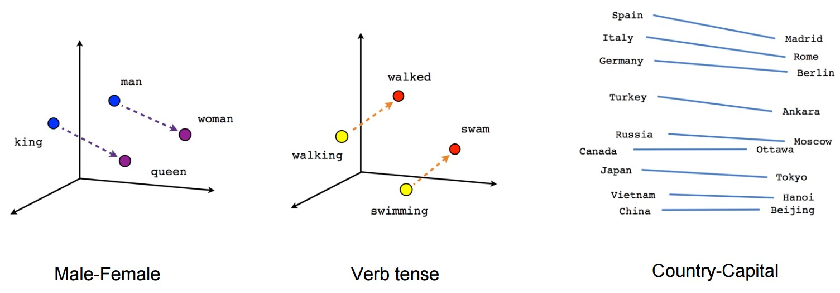
Word2Vec

Slide 25
Time series data
Closeness to major events.
Trends: Spend in last week, day, …
Fourier frequency space.
Look at Facebook's Prophet.

Slide 26
Sequence data
Two cases:
dynamic length
fixed length
Dynamic length to fixed length:
Padding: adding zeros or similar to extend.
Aggregation: average, say, 2 time steps to reach fixed length
Cutting: simply cut to the desired length (→ loss of information)
Descriptive stats or other summary statistics are the quick baselines
RNN/LSTM are often performing well on the dynamic case, can use internal memory as input features for other models.

Slide 27
Location data
IPs → do a geolocation lookup
Instance-based methods (e.g. kNN) work well on location features, can also extract "distance to instance x" as feature, this approach is called simile features.

Slide 28
Tricks - Interactions
Polynomial feature extraction often works wonders (if #features is low).
Forming interactions via symbolic regression and stochastic optimization heuristics are a lost art not to be underestimated (e.g. simulated annealing, swarm optimization, evolutionary algorithms).

Slide 29
Tricks – Kernel Approximation
Most nontrivial + nonlinear kernels have a superlinear complexity in the number of samples.
Use Nystroem-approximation to sample features from the input features to "emulate" more complex kernels, such as RBF, if it could not run on the data size.
Of course, the simile idea can also be used to generate features with the similarity towards the instances via kernel functions.
See also: random kitchen sinks.

Slide 30
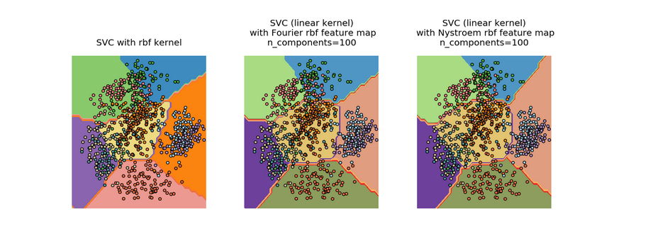
Kernel Approximations

Slide 31
Tricks – Row Statistics
Create statistics of data:
Count the number of NaNs (or bin as categories, good on „joined“ tables from databases),
Number of zeros,
Number of negative entries,
Mean, max, min, skewness or other descriptive stats of row values.

Slide 32
Pipeline API
One last thing: one should integrate preprocessing with the model selection and fitting process via pipelines
Integrated in e.g. scikit-learn, spark.ml.

Slide 33
from sklearn.decomposition import TruncatedSVD
from sklearn.pipeline import make_pipeline
from sklearn.preprocessing import Normalizer
svd = TruncatedSVD(100)
normalizer = Normalizer(copy=False)
lsa = make_pipeline(svd, normalizer)
some_data = lsa.fit_transform(some_data)

Slide 34
Outlook

Slide 35
Deep learning
Neural Networks repeatedly project onto linear spaces, then squash values for each layer. This can be seen as a successive change of data representation.
These layers can – and are – reused. How this is being done concretely in terms of training and inference is what is meant by „architecture“ on conferences.
Transfer learning: learner able to use knowledge of past learning problem (of a different structure) in a new one.
We hope neural networks can do it, they have proven it in e.g. WaveNet (text to speech).
Next slide show a simple convolutional net transformation.

Slide 36
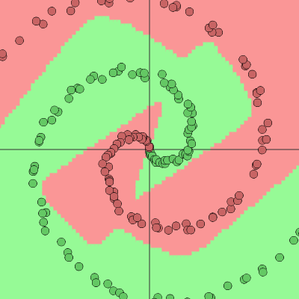
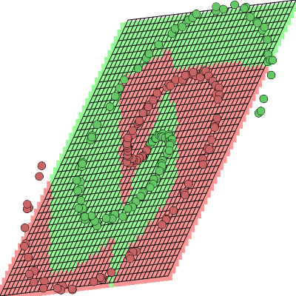
Orig. Dataset - plane in layer 1

Slide 37
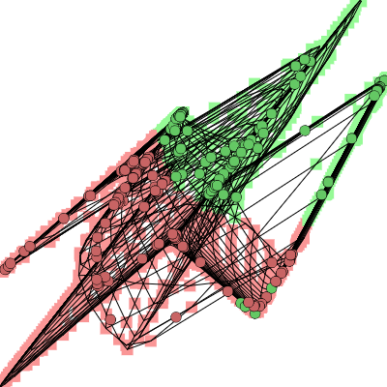
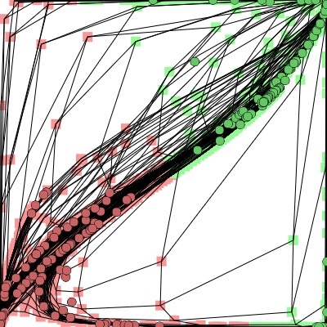
After squash - last hidden

Slide 38


Art of Feature Engineering
The „Data Scientist spend 80% of their time cleaning data“ meme actually is about finding the right data presentation.
Feature engineering is what usually made a great machine learner, deep learning (= throwing GPU/CPU instead of IQ/g-factor) increasingly more successful.

